Slide 1
P,NP and NP complete problems
Final Chapter

Slide 2
Types Problems
There are various kinds of computational problems

Slide 3

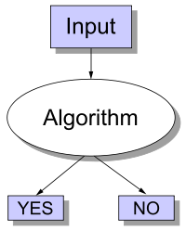
Decision Problems
Problems where the answer is either YES or NO

Slide 4
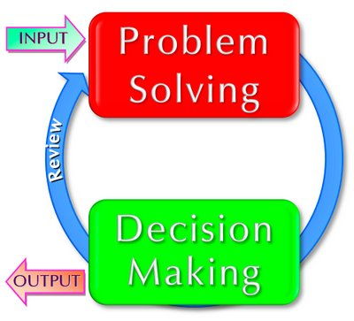
Decision Problems
Problems where the answer is either YES or NO
This simplifies notation and allows us to write
x∈Q in place of Q(x)=YES
and x∉Q in place of Q(x)=NO.

Slide 5
Decision Problem: Examples
Decision problem:
Input: a natural number x,
Question: is x an even number?
Membership Problem:
Input: a natural number x,
Question: is x in Even={0,2,4,6,⋯}?
We refer to the YES answer on an input as accepting the input
and to the NO answer on an input as rejecting the input.

Slide 6
P class Definition
The class of polynomially solvable problems, P contains all sets in which membership may be decided by an algorithm whose running time is bounded by a polynomial.

Slide 7
P class problems
Problems with Efficient Algorithms for Finding Solutions
Efficient algorithms:
algorithms that use at most polynomial amount of computational resources
algorithms that have polynomial worst-case running time
P is the class of decision problems that can be solved efficiently
decision problems which have polynomial-time algorithms.

Slide 8
P class problem
a decision problem Q is in P iff there is an efficient algorithm A such that for all inputs x,
if Q(x)=YES then A(x)=YES,
if Q(x)=NO then A(x)=NO.
Searching of key elements
Sorting of elements
All pairs shortest path

Slide 9
NP class Problems
Problems with Efficient Algorithms for Verifying Proofs/Certificates/Witnesses
decision problems for which we do not know any efficient way of finding the answer
however if answer is provided with a proof, we can efficiently verify that the answer is correct or not by checking the proof .

Slide 10
NP class Definition
The class of nondeterministic polynomially acceptable problems, NP, contains all sets in which membership can be verified in polynomial time.

Slide 11
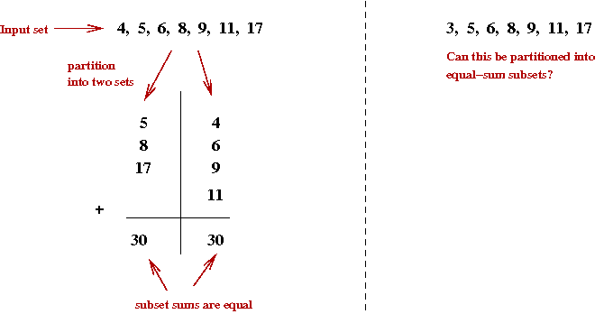
NP class Problems : Example
Partition
Input: a finite set of natural numbers S,
Question: partition S into two sets A and B
A∪B=S & A∩B=∅
such that the sum of the numbers in A is equal to the sum of number in B
(∑x∈Ax=∑x∈Bx)?

Slide 12
Partition Problem: Solution
Given a set S and ask you to partition it into two sets such that their sums are equal
Do you know any efficient algorithm to solve it?
Method : try all possible ways of partitioning the numbers into two sets until you find a partition where the sums are equal
[complexity is exponential]
If any of them worked you would say YES, otherwise you would say NO.

Slide 13
NP: Partition Problem: Example
example: A={2,4} and B={1,5} S={1,2,4,5}
can be partitioned into two sets with equal sums.
We just need to sum up the numbers in A and the numbers in B and see if the results are equal, and check if A, B is partition of S.
If A={2,5} and B={1,4}
The proof is invalid.
It does not mean the answer is NO, it just means that this particular proof was invalid.
Your task here is not to find the answer, but only to check if the proof you are given is valid or not.

Slide 14
NP formal definition
a decision problem Q is in NP iff
there is an efficient algorithm V [verifier] such that for all inputs x,
if Q(x)=YES then there is a proof y such that V(x,y)=YES,
if Q(x)=NO then for all proofs y, V(x,y)=NO.
TSP
Graph coloring problem
Knapsack Problem
Hamiltonian circuit problems

Slide 15
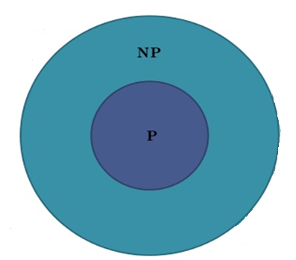
P⊆NP
P=efficient solvable and
NP=efficiently verifiable.
So P=NP iff
any problem in P is also in NP
Is NP = P ?

Slide 16
NP: Example
Input: a list of n +1 natural numbers a1,⋯,an, and s,
Question: is Σn_{i}=s?
The problem is in P because we can sum up the numbers and then compare it with s,
we return YES if they are equal,
and NO if they are not.
The problem is also in NP.
Consider a verifier V that gets a proof plus the input for Sum.
It acts the same way as the algorithm in P that we described above.
This is an efficient verifier for Sum.

Slide 17
Overview of P and NP problems
P denotes the class of computer algorithms which can be executed in a fast way in order to solve a decision or a search problem.
NP corresponds to that problem which can be checked for solution correctness in a fast way whenever a solution is provided.

Slide 18
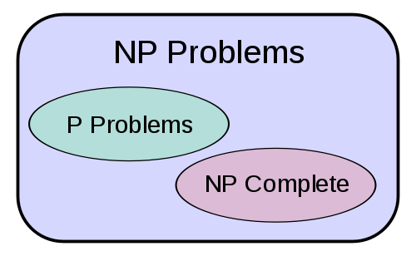
P Vs NP

Slide 19
The Problem P Vs NP
The P vs. NP problem asks whether every problem whose solution can be quickly verified by a computer can also be quickly solved by a computer.
P problems are easily solved by computers
NP problems are not easily solvable

Slide 20
P != NP?
It currently appears that P ≠ NP.
we have plenty of examples of problems that we can quickly verify potential answers to, but that we can’t solve quickly.

Slide 21
Examples : P != NP
A traveling salesman wants to visit 100 different cities by driving, starting and ending his trip at home. He has a limited supply of gasoline, so he can only drive a total of 10,000 kilometers. He wants to know if he can visit all of the cities without running out of gasoline.

Slide 22
Examples : P != NP
A farmer wants to take 100 watermelons of different masses to the market. She needs to pack the watermelons into boxes. Each box can only hold 20 kilograms without breaking. The farmer needs to know if 10 boxes will be enough for her to carry all 100 watermelons to market.

Slide 23
NP: some more examples
Consider final examination scheduling.
A school has n courses and 5 days in which to schedule examinations.
An optimal schedule would be one where no student has to take two examinations on the same day.
This seems like an easy problem.
But there are O(5^{n}) possible different schedules.

Slide 24
Example cont.…
If we check them with a computer which could check a million schedules every second, the time spent checking for a value of n = 50 would be about
Any guesses?
200,000,000,000,000,000,000 years!

Slide 25
Summary
P vs. NP deals with the gap between computers being able to quickly solve problems vs. just being able to test proposed solutions for correctness.
As such, the P vs. NP problem is the search for a way to solve problems that require the trying of millions, billions, or trillions of combinations without actually having to try each one.
Solving this problem would have profound effects on computing, and therefore on our society.

Slide 26
NP complete problems
NP-complete means most difficult NP problems
if we can solve an NP-complete problem efficiently, we can solve all NP problems efficiently.

Slide 27
NP complete and NP Hard
decision problem A is NP-complete iff
A is in NP, and
for all NP problems B, B in polynomial-time may reducible to A (B≤PmA).
NP-hardness is a way of saying that a problem is difficult.

Slide 28
Computational Complexity Problems
Complexity problems
NP Class
NP Hard
P Class
NP Complete

Slide 29
